Slide 1
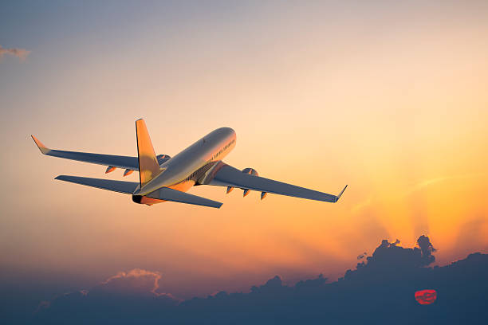
FLIGHT PRICE DASHBOARD REPORT
Vistara airline is having highest price compared to other airlines, where as SpiceJet, GO_FIRST, Indigo, AirAsia have very lower price i.e. almost 20% of Vistara.
Flight leaving late night have lower price which 40% of flight leaving night and evening arrival flight are costlier than other time arrivals.
Economy class seats are cheaper than business class.
Journey from and to Delhi from any airport is cheaper compared to journey to other airport.
As travel time increase there is increase in price of flight

